Slide 1
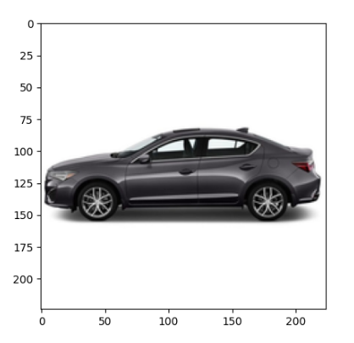
Multi-modal learning to facilitate car body design - explore machine learning, 3D modeling, and fluid dynamic simulations
UROP Student: Hanqi Su
Faculty Supervisor: Faez Ahmed
Direct Supervisor: Binyang Song
Term: 2022 Fall
2022.11.30

Slide 2
Workflow Schedule
Date | Milestones
2022.10.04 - 2022.10.17 | 3D data classification (manually)
2022.10.18 - 2022.10.24 | Learn basic knowledge about CNN: principles, methods, optimization, development
2022.10.25 - 2022.10.31 | Image data process + construct CNN model
2022.11.01 - 2022.11.07 | Parameter tuning about CNN model
2022.11.08 - 2022.11.15 | Tabular data reconstruction + paper reading
2022.11.16 - 2022.11.22 | Construct MLP model for tabular data processing + parameter tuning
2022.11.23 - 2022.11.29 | A new way for data split + parameter tuning + mix two model to construct muti-modal learning model
TBD TBD

Slide 3
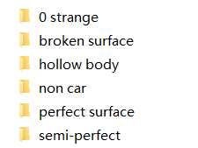
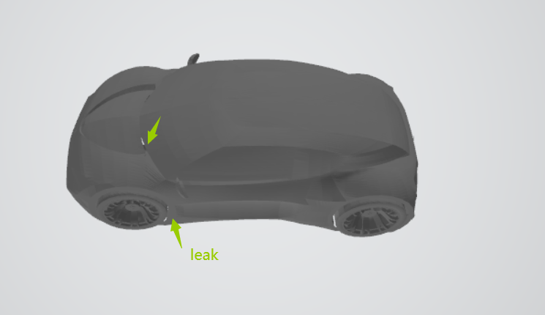
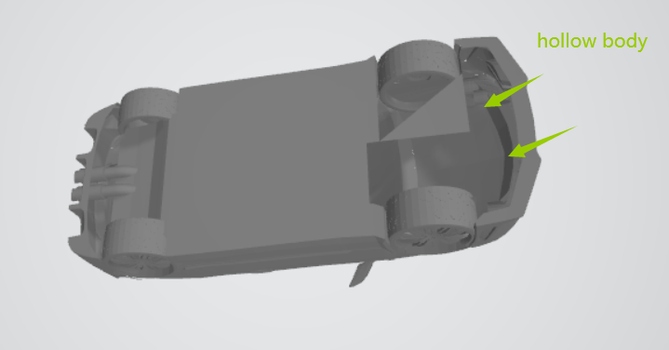
3D data classification (manually)
Type | Description
non car | not typical car type (like a truck)
semi-perfect | in the bottom of the car, there are some holes which can make the air go through
broken surface | the surface should be perfect, but it has some leaks instead
perfect surface | A good car
hollow body | some holes in the top of the car or does not have windows

Slide 4
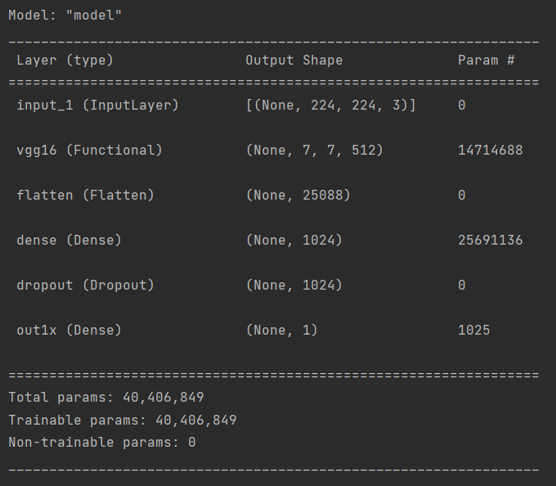
Image Data Process
CNN Model (predict MPG)
Vehicle info.csv 4317 car models
Data Process
car_MPG modify.csv 3576 car models
Data Split => Train : Test = 7:3
Stratified sampling according to MPG values
Visualization
Draw scatter picture => ground truth - predict
Show the result of MSE and MAE
Show the epochs with training loss and validation loss
Show the value of r-squared
The best model
VGG16 => Learning rate -> scheduler + one layer + 1024 neurons + 0.5 dropout rate + 15 patience
MSE: 75.7739
MAE: 3.7990
r-squared: 0.6433502981659011

Slide 5
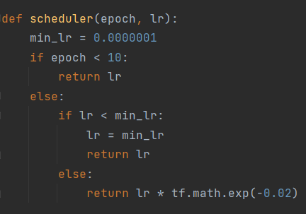
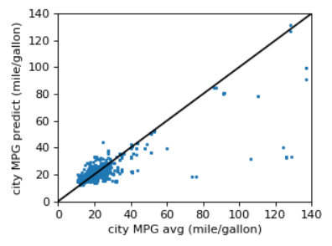
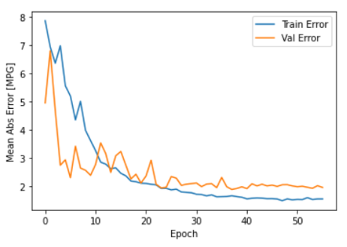
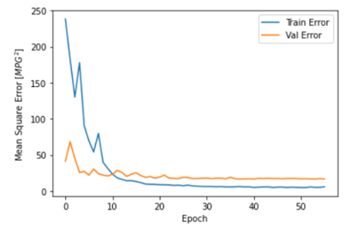
Parameter Tuning about CNN model
Parameters:
• Learning rate -> scheduler
• The number of layers： 1
• Number of neurons： 1024
• Dropout rate： 0.5
• Number of patience： 15
• Different pre-trained models： VGG16

Slide 6
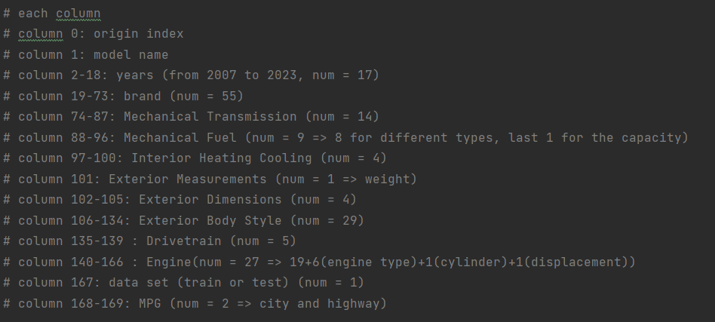
Tabular Data Process
Data Split => Train : Test = 7:3
configurations info.csv 36385 car config
Based on the image data split
Mapping image data and the tabular data
Data Process
Input dara.csv 21893 car config
0-1 embedding or direct num value
Consider 10 types of different factors
Visualization
Draw scatter picture => ground truth - predict
Show the result of MSE and MAE
Show the epochs with training loss and validation loss
Show the value of r-squared

Slide 7
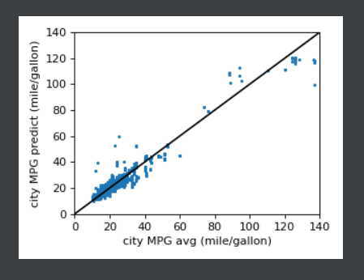
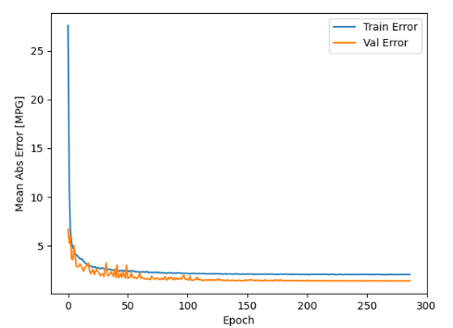
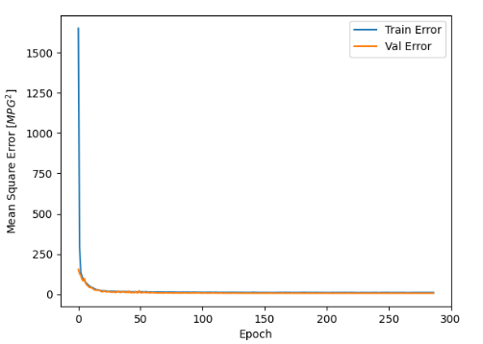
Parameter Tuning about MLP model
Parameters:
• Learning rate -> scheduler
• The number of layers： 2
• Number of neurons： 170 100
• Dropout rate： 0.1
• Number of patience： 20
• Batch_size: 24
Total columns: 165 columns
Best Model
MSE: 6.3254
MAE: 1.6819
r-squared: 0.9156989857584197

Slide 8
Find which may be more informative
Total train columns: 165 columns: 91.4%
column 2-18: years (from 2007 to 2023, num = 17)
column 19-73: brand (num = 55)
column 74-87: Mechanical Transmission (num = 14)
column 88-96: Mechanical Fuel (num = 9 => 8 for different types, last 1 for the capacity)
column 97-100: Interior Heating Cooling (num = 4)
column 101: Exterior Measurements (num = 1 => weight)
column 102-105: Exterior Dimensions (num = 4)
column 106-134: Exterior Body Style (num = 29)
column 135-139: Drivetrain (num = 5)
column 140-166 : Engine(num = 27 => 19(engine description)+6(engine type)+1(cylinder)+1(displacement))
Informative columns: => r-squared:89%
Engine: 18%
engine description: 12%
engine type: 2%
cylinder: 2%
displacement: 2%
Exterior Dimensions: 9%
Exterior Measurements: 3%
Mechanical Fuel Capacity: 2%
If one loses any one of them, the decrease in r-squared

Slide 9
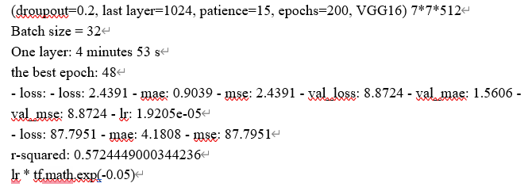
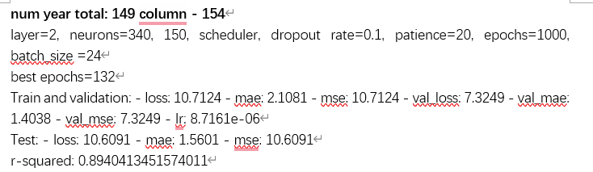
A new way for data split
Consider that the same car name but in different may provide some potential information for the prediction. Then we reconsider that if the car name is the same then we put them all in train data or test data.
Data Split => Train : Test = 7:3
Best Model for Image Data
MSE: 87.7951
MAE: 4.1808
r-squared: 0.5724449000344236
Best Model for Tabular Data
MSE: 10.6091
MAE: 1.5601
r-squared: 0.8940413451574011
7%
2%

Slide 10
Construct muti-modal learning model
Image Data
CNN Model Embedding
Concatenate Two Embedding
Predict MPG
MLP Model Embedding
Tabular Data
Problem:
21893 rows => too large for numpy array to store image data, RAM cannot undertake
Still working on that

Slide 11
Thank You ! ! !
Hanqi SU
2022.11.30

